Slide 1

The Dominant Force in Junior Golf

Slide 2

BGGA
A leading Boarding School for elite junior golfers…study, golf, play and stay.
Excellent private school, exceptional student housing on a private golf estate, the very best golf practice facilities
BGGA started with 5 students in February 2014, 25 students in August 2015, 65 students in August 2017 and 70 in August 2018.
Capacity for up to 120 golf students
54 student transfers from other golf academies in the last 4 years.

Slide 3

GOLF ACADEMY CHECK LIST
Corporate Structure - the foundation, and being a people business, a partnership the best structure.
Financially solid is important, to reassure students and staff of their future.
Outstanding golf program, with the best golf practice facilities and experienced team of highly motivated golf coaches.
Excellent academic program, with tutoring support for students.
Character/Leadership development, based in warm but strict housing environment.
See Appendix II for scorecard, compared to our perception of competitors.

Slide 4

BUSINESS PHILOSOPHY
At less than 50 students unlikely to have sufficient critical mass to afford full service in golf, housing and academics.
Often structured as a sole member company, where senior staff don’t have an equity interest or decision making.
At over 150 students very difficult to control the peer group of students to ensure focus on character development.
Often structured as a corporation, with shareholders driven by financial return rather than a passion for the students.
We believe that the ideal size is at about 100 students, to have sufficient financial resources to offer the full complement of services, to afford a campus environment and to control the development of character and leadership in students.
Ideal if structured as a partnership, with senior staff having ownership and decision making, which is motivating.

Slide 5

GOLF PROGRAM
Based on the principal of M.A.P – Mastery, Autonomy and Purpose.
Kevin Craggs, PGA Advanced Fellow Professional and Director of Golf Instruction, leads the golf coach team. We have an excellent team of 10 golf coaches with an unparalleled average experience in junior golf in excess of 10 years.
Structured in POD teams, with 2 golf coaches in each POD and each POD allocated 2 stations on the range, they afford students the opportunity to personalize their training program.
With an emphasis on the strategic selection of tournaments for competitive experience and to raise profile for college.
Exceptional in-house competition to develop enjoyment and confidence in competition, with easy access to weekend golf.
All provided in what is considered the best junior golf training campus in the world, probably the only golf course and range where juniors have priority over residents and members, and outside of regular practice can play in “casuals”.

Slide 6


COACHING TEAM
Kevin Craggs – Director of Golf Coaching and Instruction
After playing on Golf Tours around the world for years, Kevin transitioned into coaching and for many years was the coach to the Scottish National Team. He built his career on successfully improving the games of golfers at all levels from junior golfers, club golfers through to tour players on both the U.S. and European Tours.
Over the last 10 years, Kevin’s teaching philosophies have regularly been featured in two top selling golf magazines and featured 12 times on front covers.
Read testimonials from players and the media here.

Slide 7
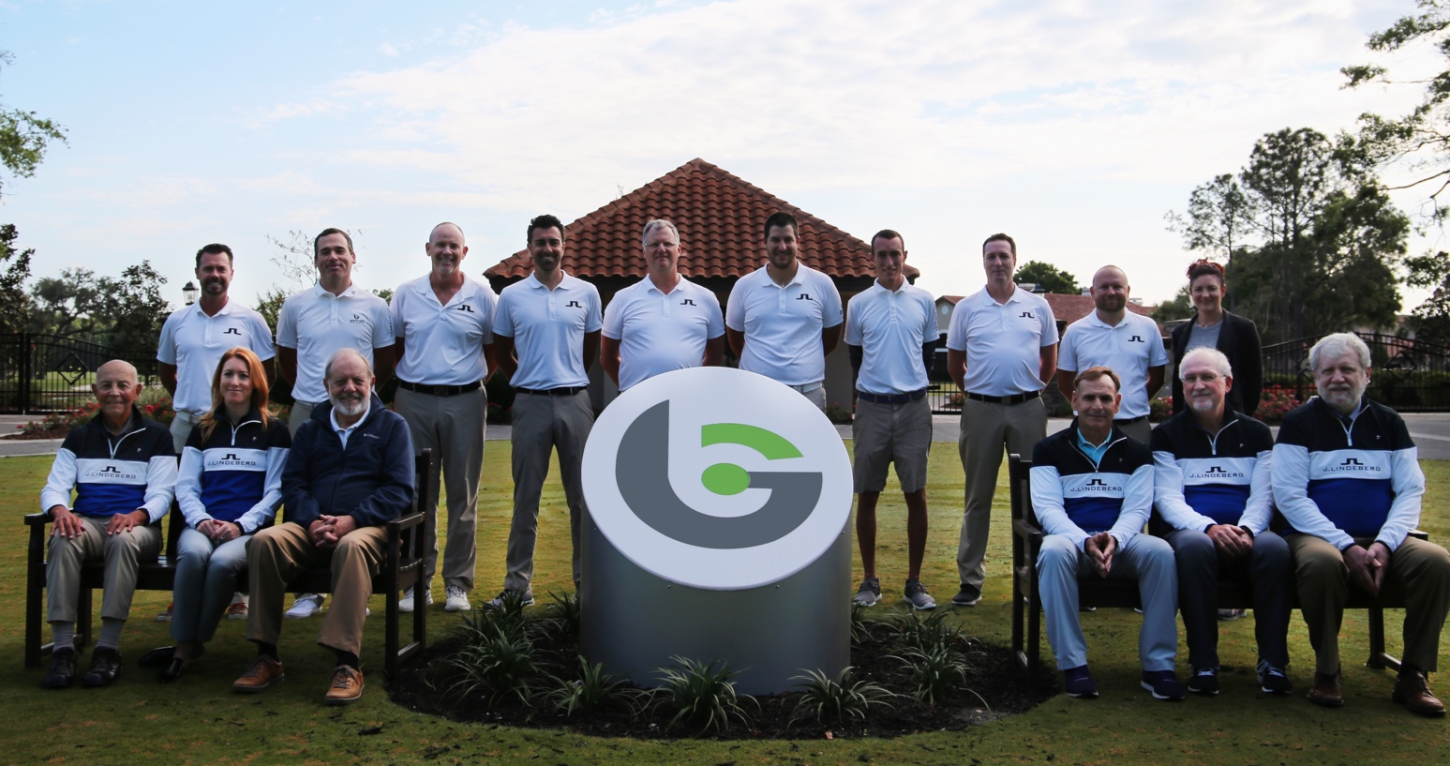
COACHING TEAM
The BGGA Advisory Board includes an extraordinary cadre of scientific leaders in areas of neuroscience, mental performance, biomechanics, health and athletic development, learning sciences and elite performance.
The BGGA Advisory Board is critical to our student development, and also to the development of our coaches.
The structure of the golf program has two main elements - one obviously being the Coaching and Instruction of students, but also very importantly we recognize the importance of many areas of the golf program that require professional Management and Organization.
Excellent team of golf and performance development professionals, with an average of over 10 years experience in junior golf.
POD coaching concept to allow students autonomy in their development program.

Slide 8

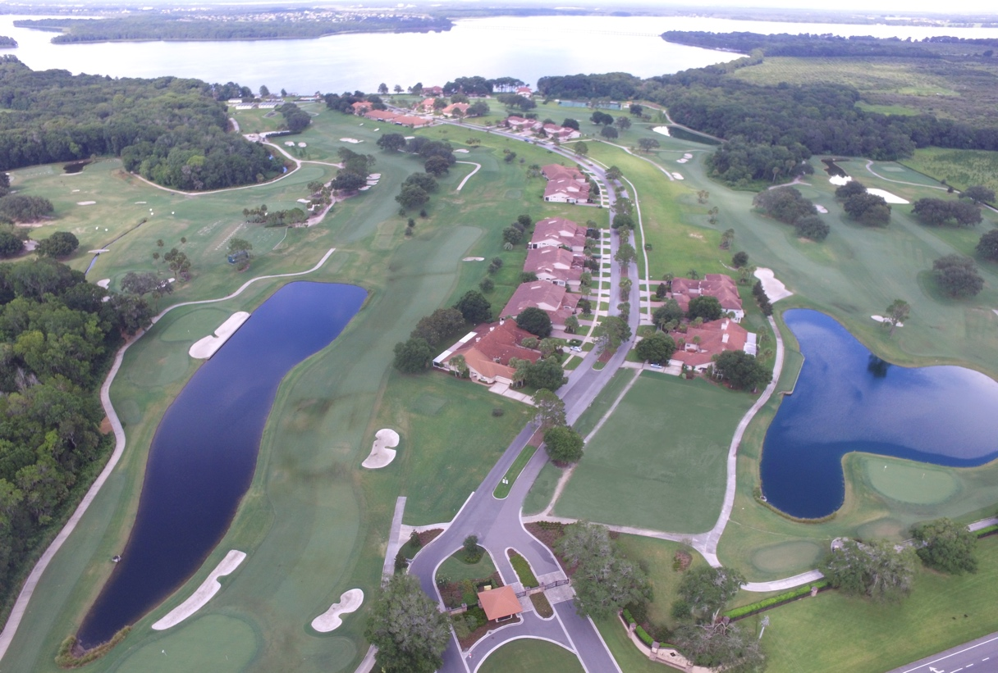
FACILITIES
Known to have the best facilities in junior golf, BGGA offers a place where athletes eat, sleep and train.
Inclusive of the student-centered golf course, housing, Learning Center, Champions dining hall, a swimming pool, tennis courts, basketball court, social spaces and game rooms, our campus creates an atmosphere that's unlike any other.
With all accommodations and training facilities on one centralized campus, athletes focus on athletic growth and enjoyment.
45 minutes from Orlando International Airport.
First-class training facility with a 16-acre range and 9/18 hole golf course.
Train in golf course conditions every day, uniquely with priority over residents / members.
50,000 square feet of training tee space; 30,000 square feet of putting and short game greens; 15,000 square feet of bunkers.

Slide 9

ACADEMIC PROGRAM
Our partner school is Montverde Academy. With over 100 years of educational experience, Montverde Academy is an international, co-educational, college preparatory school that offers considerable advantages to BGGA student-athletes seeking the highest quality education.
Montverde Academy is also home of U.S. Championship winning soccer and basketball academies, top rated baseball team, as well as competitive tennis and swimming academies.
BGGA has its own Learning Center, providing the following services:
- Study Hall, with tutors for students who need support with school work.
- Study Hall, as a quiet place for students who wish to study with peer group.
- Tutoring in a range of subjects, including English as a Second Language (ESL).
- Tutoring in ACT, SAT and TOEFL.
As an alternative BGGA offers the Hilton Head, South Carolina, Heritage Academy’s Synchronous Education, providing a full college preparatory education in real time classes with live teacher and student interaction through video conferencing.

Slide 10
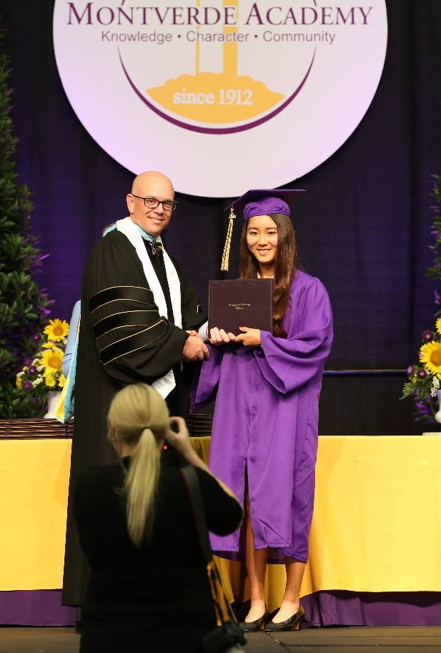
MONTVERDE ACADEMY
Not-for-profit with over 1,300 students, noted for its strong academic program and its sporting excellence.
Soccer Academy of 200 students, undefeated at the high school level over the last eight years.
Basketball program has been U.S. champions in four of the last six years.
Baseball team ranked first in the nation.
Tennis Academy with around 30 students.

Slide 11
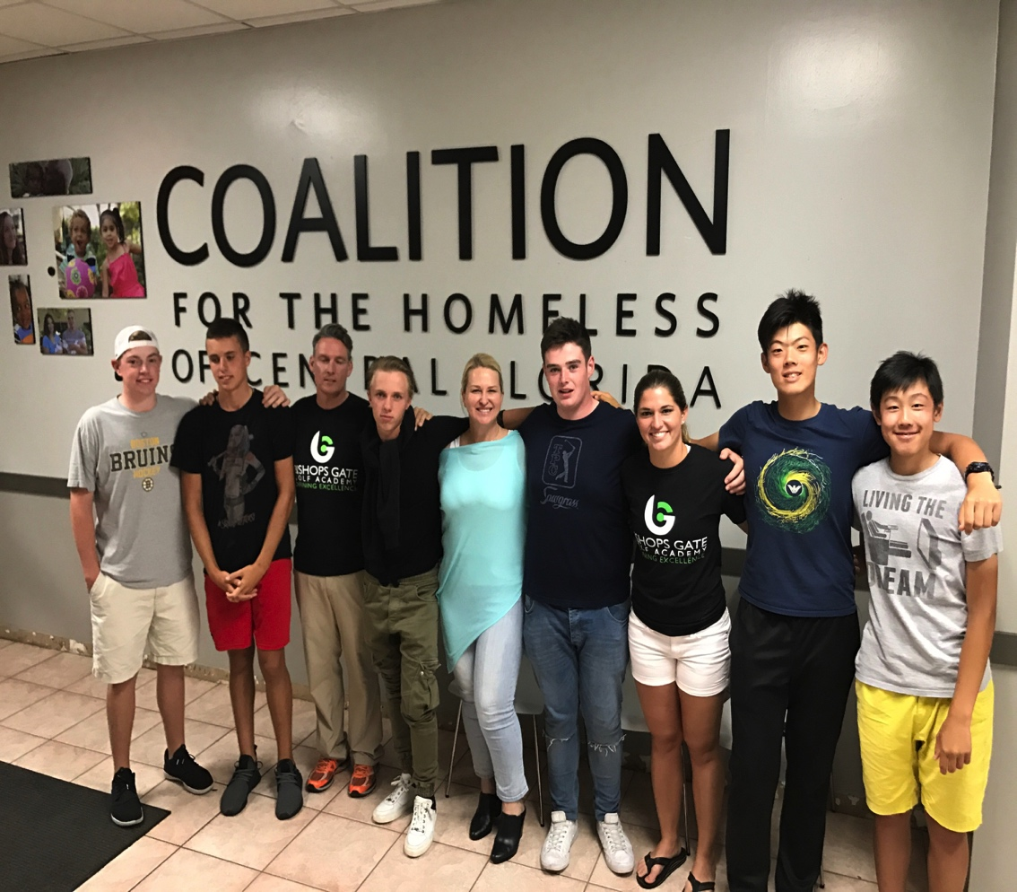
CHARACTER / STUDENT LIFE
Developing character traits of Grit, Determination, Self-Esteem, Self-Confidence, Sociability.
We are exceptionally proud of our Peer Group, who share the common experience of making sacrifices in leaving home, often having the courage to study in a foreign country, in a foreign language, and having the ambition for greatness as a professional golfer or at least an outstanding college golf experience. The student influences on each other is amazing, and we manage this with light touch.
Senior students are elected as role model Ambassadors and participate in fortnightly Leadership programs. All students participate in weekly Character sessions based on the college athlete Habitude program.

Slide 12
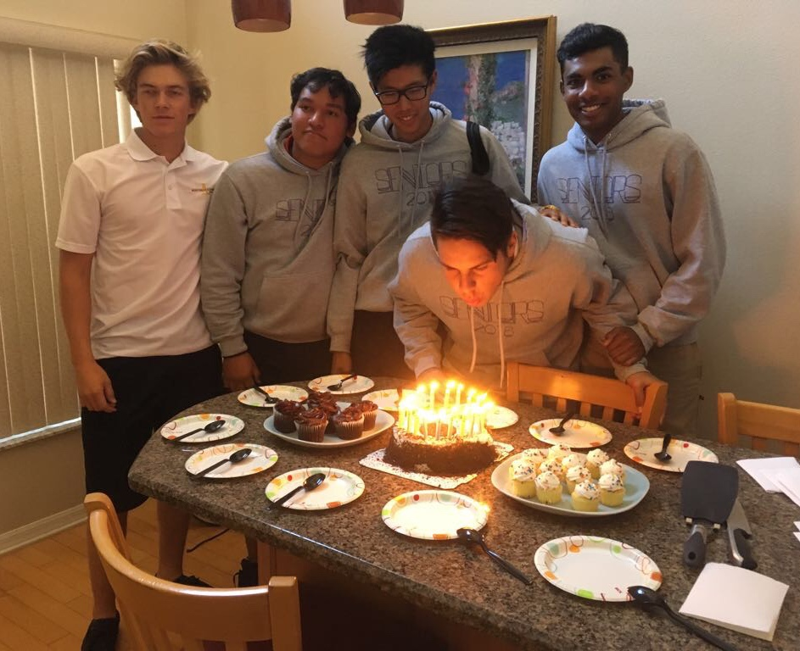
CHARACTER / STUDENT LIFE
Students are housed in private condos, creating a “home away from home” environment, in a gated community, and are supervised and supported by a mix of experienced and youthful House Parents.
With regular input from the students, house parents organize extensive Weekend Activities for students to select from, ranging from fun activities at the Orlando theme parks, to shopping trips and some more ambitious challenging activities.

Slide 13

HOUSING
Upscale, spacious, fully furnished condos.
Room with either one or two students with a maximum of six students per home.
Living room, dining room, fully-appointed kitchen and laundry room and an enclosed patio for relaxation and games.
Wireless Internet access and satellite television.
24/7 oversight by resident house parents.
Inside a private, gated community, with emphasis on security in homes and the community.

Slide 14

STUDENT OUTCOMES
95% of Full-Time students have gone on to college golf experiences, with on average 50% scholarships.
95% of Post Graduate students have gone on to college golf experiences, with on average 50% scholarships.
Although we cannot guarantee this performance, as very much down to each individual.
Some students go on to exceptional success, winning important amateur events or turning professional.

Slide 15
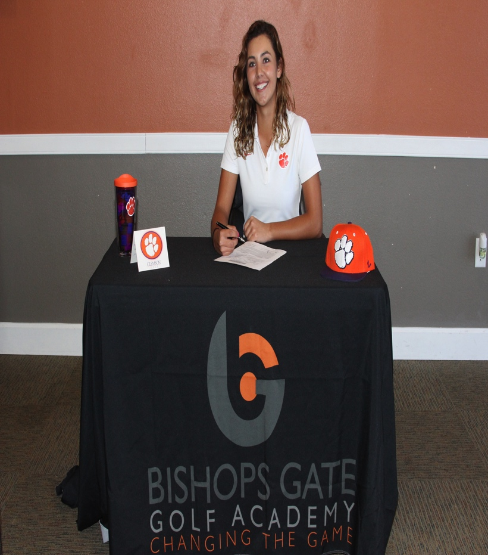
STUDENT OUTCOMES
BGGA is the Dominant Force in Junior Golf. By our estimate, as many wins in aggregate as our top competitor golf academies combined.
In our nearly four years since inception, we have an impressive list of student successes with over 100 tournament wins.
Although not measurable, our true measure of success is in developing fine young people, well prepared for life and college, with strong values and a good golf game, for many years of enjoyment with friends.
2014-15: 14
2015-16: 24 wins
2016-17: 27 wins
2017-18: 56 wins
See Appendix I of notable college and golf successes.

Slide 16
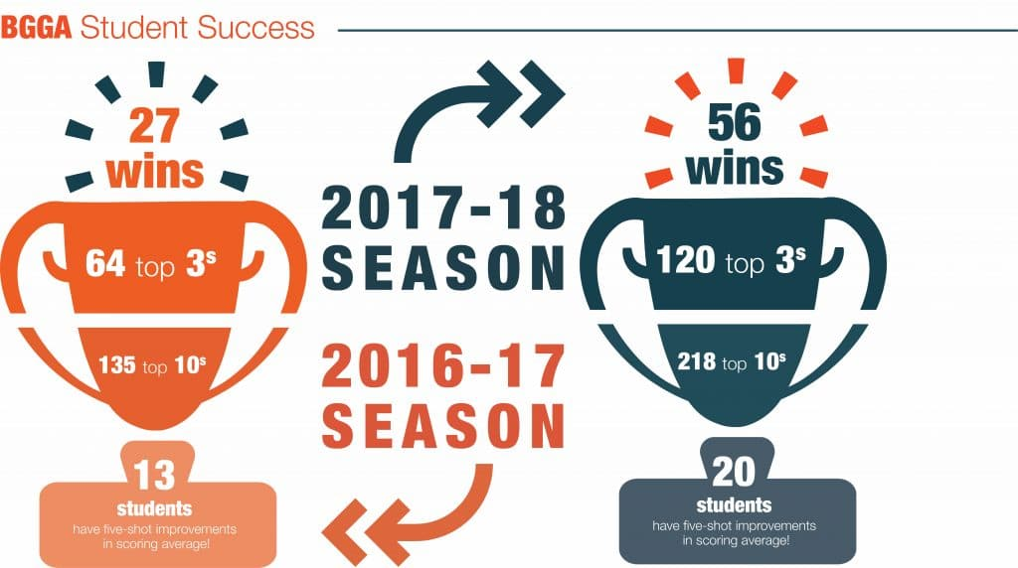

Slide 17
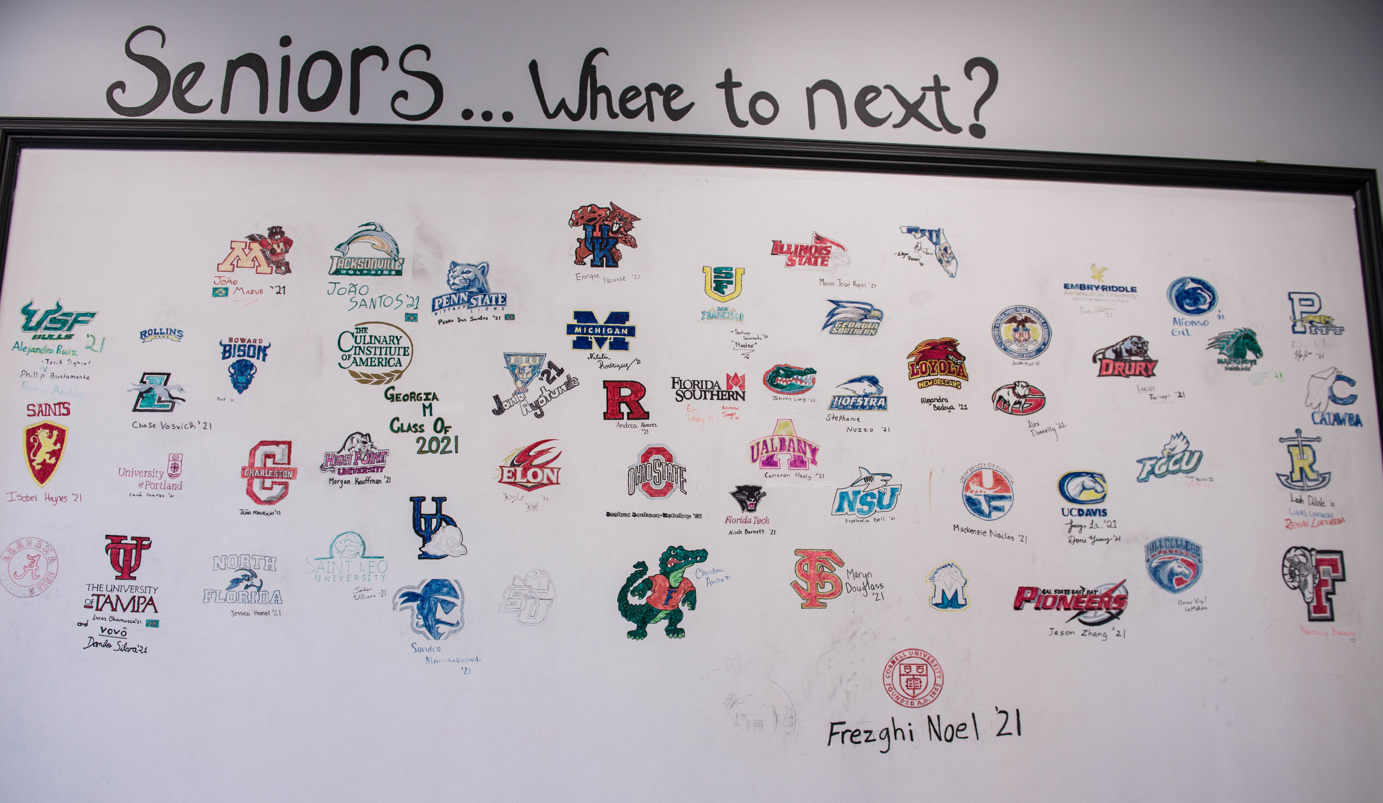
COLLEGE PLANNING + PLACEMENT
Extensive College Planning and Placement service, starting from 8th grade in establishing goals, with students then guided in golf and academics towards achieving these goals, with parents and students expectations managed carefully throughout.
Our College Advisory team work with an extensive network of College Golf Coaches, providing options to students and supporting them in their applications, communication and visits with colleges.
BGGA offers a College Planning and Placement Program in the summer months, focused exclusively on preparing students for application process and college coach communications and visits.

Slide 18
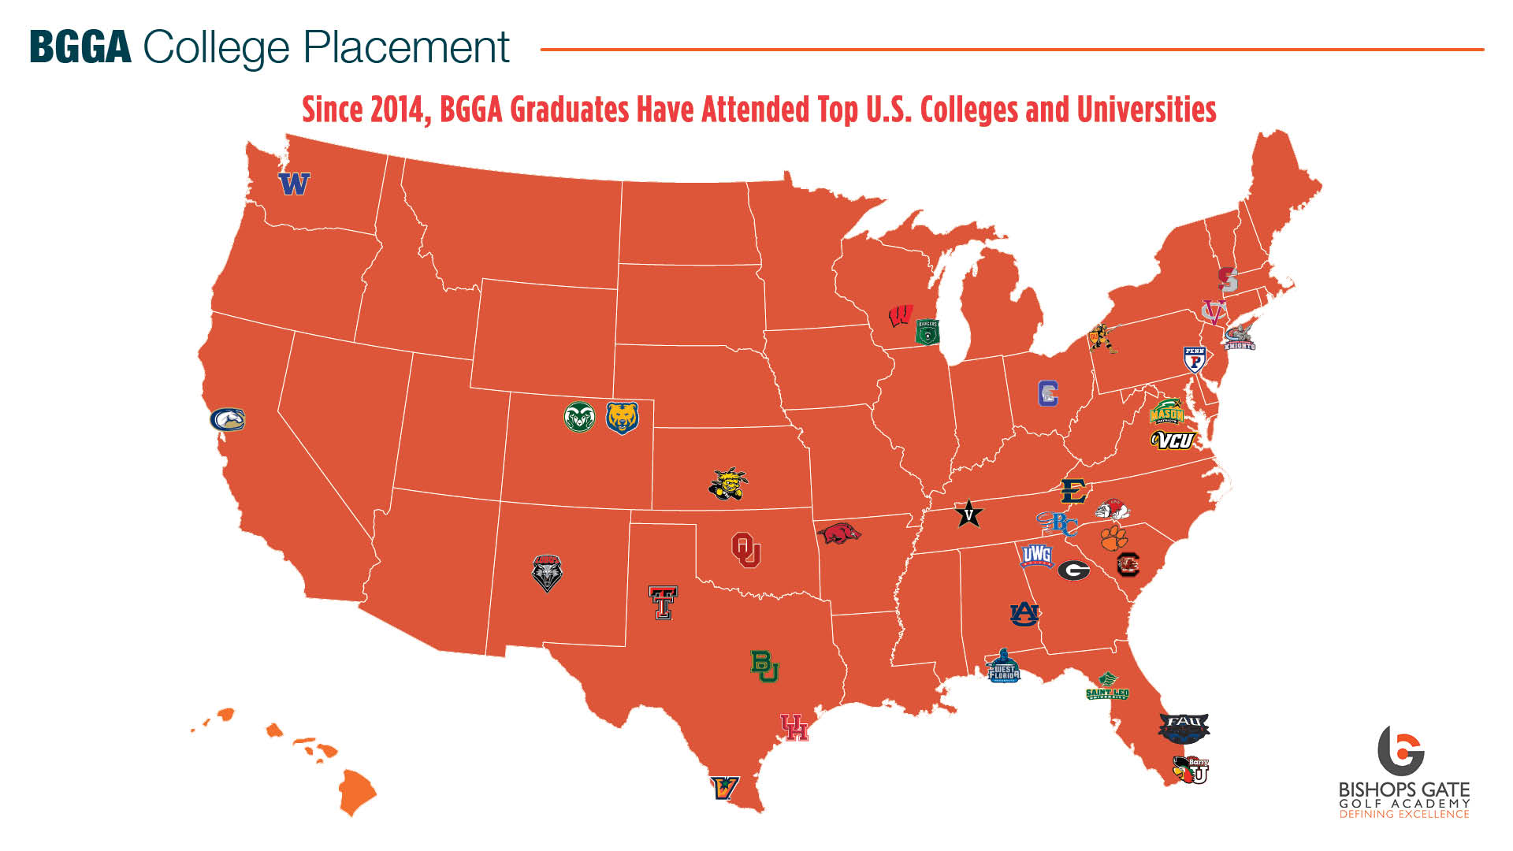

Slide 19

NEW STUDENT ORIENTATION PROGRAM
BGGA recommends that every new student join our Orientation Program before each fall semester begins.
Students get a head start with English language before the academic school year begins.
Orientation allows students the opportunity to begin the golf assessment and blueprinting process giving them a head start on their golf training.
Students acclimate to their new environment. By moving on campus before classes start, new students are able to learn the ropes. Through guided tours of Montverde Academy and the campus, orientation provides a safe avenue for new students to find their way around.

Slide 20
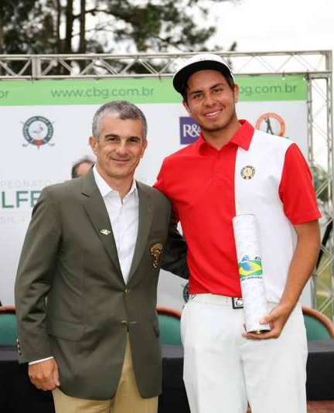
STUDENT SUCCESSES
APPENDIX I
GOLF
Julian Perico wins 2017 South American Amateur, 2017 IMG World Junior, 2017 AJGA Memorial Junior, 2018 AJGA Boys Simplify Invitational, Peruvian Pro Event.
- Siyan Chen wins three Florida Junior events in 2016/17, the first junior to do so.
Robin Williams ranked No. 1 in Europe for his age (16). Played in his first professional event, the British Masters, in September 2017. Won four AJGA events.
Petr Hubry wins 2017 Doral / Publix and Thomas Pfoestl wins 2017 Optimist.
Teddy Tetak, Annie Kim, Egor Zotov and Ying-Ting Hsieh win Faldo Series U.S. Final age categories

Slide 21
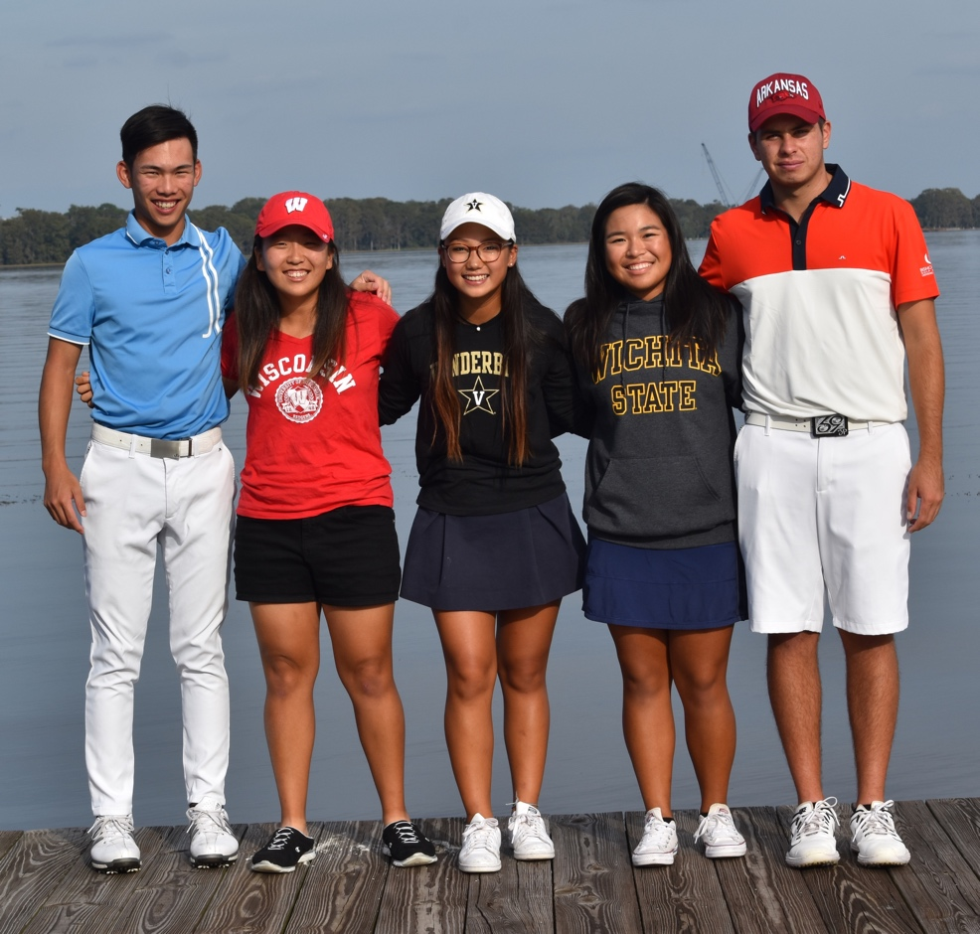
STUDENT SUCCESSES
APPENDIX I
COLLEGE
2015 6/7 graduating students went to college, 5 on scholarship (5 to D1, 1 to D2). 7th student remained at BGGA as a Post Grad student.
2016 12/15 graduating students went to college, 11 on scholarship (7 to D1, 5 to D2). Two students remained at BGGA for Post Grad.
2017 30/30 graduating students went to college, 25 on scholarship (10 to D1, 9 to D2, 10 to D3)
2018 16/20 graduating students went to college, 10 on scholarship(6 to D1, 2 to D2, 2 to D3, 1 NJCAA, 1 NAIA, 4 taking PG year)

Slide 22

COMPETITOR
CHECK-LIST
APPENDIX II
(5 high 1 low) |  | BGGA | IJGA | COMP 1 | COMP 2 | COMP 3
Corporate Structure |  | 5 | 5 | 2 | 2 | 2
Financial Stability |  | 4 | 4 | 5 | 2 | 2
Golf Program |  | 5 | 5 | 3 | 3 | 2
Academic Program |  | 5 | 4 | 3 | 4 | 3
Character Program |  | 5 | 5 | 4 | 2 | 2
TOTAL |  | 24 | 23 | 18 | 13 | 11
Note: Our point awards are subjective, and based on our outsider perceptions

Slide 23

FINANCIALS
APPENDIX III
Golf Academy Fees: $64,500 + $1,950 (transport fee/uniform) = $64,450
(inclusive of golf program, housing, catering)
With individual golf lessons, psychology and mental sessions, fitness, study hall tutoring
But additional costs for golf equipment, requested tutoring, mandatory study hall
As well as clothing apparel, school transportation and various personal services
School Fees: $16,200, but some variation according to grades and requirements
Tournament Fees: between $5,000 and $15,000, depending on number and quality of events
Other: incidental expenses for weekend activities, such as visits to Theme Parks
With spending money for golf supplies, meals when off premises etc.
TOTAL: between $80,000 and $90,000, but with a decent expectation of earning a significant college scholarship, acting as an offset of this investment in child, as well as of course the invaluable, immeasurable, development of child

Slide 24


